Slide 1
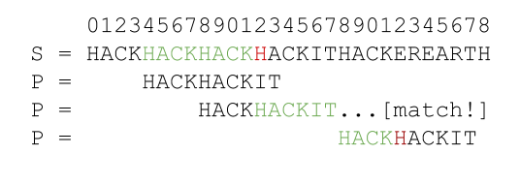
STRING PATTERN MATCHING
Team 4:
19552477 – Nguyễn trung tuấn
19522312 – Dương nguyễn thuận
19522179 – trịnh nhật tân

Slide 2
Content:
Overview
Knuth-Morris-Pratt (KMP)
Rabin Karp

Slide 3
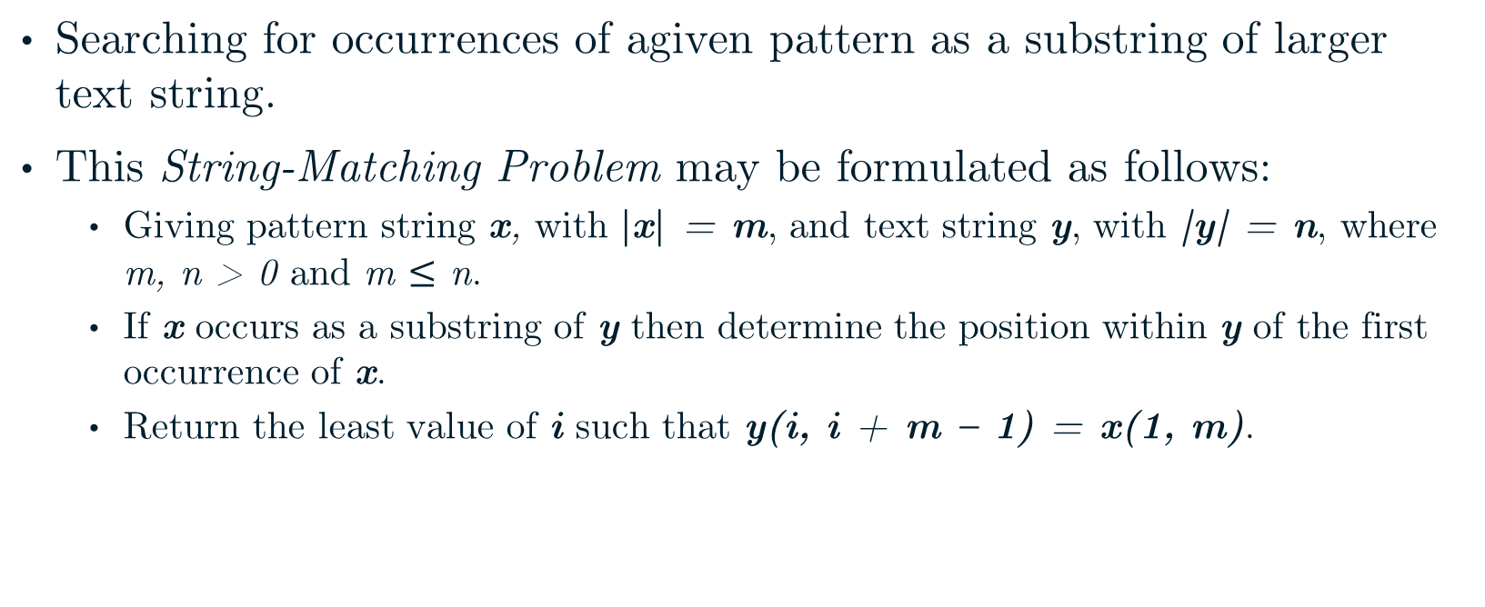
Overview
Searching for occurrences of agiven pattern as a substring of larger text string.
This String-Matching Problem may be formulated as follows:
Giving pattern string x, with |x| = m, and text string y, with |y| = n, where m, n > 0 and m $≤$ n.
If x occurs as a substring of y then determine the position within y of the first occurrence of x.
Return the least value of i such that y(i, i + m – 1) = x(1, m).

Slide 4
Overview
Input: txt[] = "AABAACAADAABAABA"
pat[] = "AABA"
Output: Pattern found at index 0
Pattern found at index 9
Pattern found at index 12
Problem:
0
9
12
0 | 1 | 2 | 3 | 4 | 5 | 6 | 7 | 8 | 9 | 10 | 11 | 12 | 13 | 14 | 15
A | A | B | A | A | C | A | A | D | A | A | B | A | A | B | A
A | A | B | A
A | A | B | A
A | A | B | A
0 | 1 | 2 | 3
A | A | B | A

Slide 5
Input: txt[] = "AABAACAADAABAABA"
pat[] = "AABA"
Output: Pattern found at index 0
Pattern found at index 9
Pattern found at index 12
Naive approach:
txt → 16
0 | 1 | 2 | 3 | 4 | 5 | 6 | 7 | 8 | 9 | 10 | 11 | 12 | 13 | 14 | 15
A | A | B | A | A | C | A | A | D | A | A | B | A | A | B | A
pattern → 4
0 | 1 | 2 | 3
A | A | B | A
Window size: 4

Slide 6
0 | 1 | 2 | 3 | 4 | 5 | 6 | 7 | 8 | 9 | 10 | 11 | 12 | 13 | 14 | 15
A | A | B | A | A | C | A | A | D | A | A | B | A | A | B | A
A | A | B | A
A
A
B
B
A
A
A | C
C
C
A
A | D
A
D
D
A
A
A | B | A
B
B
A
A | B | A
0 | 1 | 2 | 3
A | A | B | A
0 | 1 | 2 | 3
A | A | B | A
0 | 1 | 2 | 3
A | A | B | A
0 | 1 | 2 | 3
A | A | B | A
0 | 1 | 2 | 3
A | A | B | A
0 | 1 | 2 | 3
A | A | B | A
0 | 1 | 2 | 3
A | A | B | A
0 | 1 | 2 | 3
A | A | B | A
0 | 1 | 2 | 3
A | A | B | A
0 | 1 | 2 | 3
A | A | B | A
0 | 1 | 2 | 3
A | A | B | A
0 | 1 | 2 | 3
A | A | B | A
0 | 1 | 2 | 3
A | A | B | A
A
A | A | B | A
A
A
A
A
A
A | B
A
A
A
A
A | B
A
A
A
A | B | A
A
A
A
A
A | B | A
Pattern is found at index 0
Pattern is found at index 9
Pattern is found at index 12

Slide 7
Can we avoid matching the characters that we know they will match anyway?

Slide 8
Example: Skipping Positions
0 | 1 | 2 | 3 | 4 | 5 | 6 | 7 | 8 | 9 | 10
A | B | R | A | C | A | D | A | B | R | A
A
A | B | R | A
B | R | A
0 | 1 | 2 | 3
A | B | R | A
A
A
R | A
B | R | A
B | R | A
A | B | R | A
0 | 1 | 2 | 3
A | B | R | A
0 | 1 | 2 | 3
A | B | R | A
0 | 1 | 2 | 3
A | B | R | A
A
A | B
A | B | R
A | B | R

Slide 9
Example: Skipping Positions
0 | 1 | 2 | 3 | 4 | 5 | 6 | 7 | 8 | 9 | 10 | 11
A | B | C | D | A | B | C | D | A | B | E | F
A | B | C | D | A | B
A | B
A | B
A | B | C | D | A | B | E | F
A | B
0 | 1 | 2 | 3 | 4 | 5 | 6 | 7
A | B | C | D | A | B | E | F
A | B
A | B
A | B | C | D | A | B
A | B | C | D | A | B | E | F
A | B
A | B

Slide 10
Example: Skipping Positions
0 | 1 | 2 | 3 | 4 | 5 | 6 | 7 | 8 | 9 | 10 | 11
A | B | A | B | A | B | A | B | A | B | E | F
A | B | A | B | A | B
A | B | A | B | A | B | E | F
A | B | A | B
A | B | A | B | A | B
A | B | A | B
0 | 1 | 2 | 3 | 4 | 5 | 6 | 7
A | B | A | B | A | B | E | F
0 | 1 | 2 | 3 | 4 | 5 | 6 | 7
A | B | A | B | A | B | E | F
A | B | A | B | A | B
A | B | A | B
A | B | A | B
A | B | A | B
A | B | A | B
A | B | A | B | A | B | E | F
A | B | A | B | A | B

Slide 11
Definitions:
String X is a substring of string Y when X is a sequence of consecutive characters of Y.
String X is a prefix of string Y when X is a substring of Y and X presents at the beginning of Y.
X is a proper prefix of Y if X is a prefix of Y and different from Y.
String X is a suffix of string Y when X is a substring of Y and X presents at the end of Y.
X is a proper suffix of Y if X is a suffix of Y and different from Y.

Slide 12
c | a | b
b
a | b | c | b | c | a | b
b | c | a | b
b | c | b | c | a | b
a | b | c | b | c | a
a
c | b | c
a | b | c | b | c | a | b
a | b
a | b | c | b
a | b | c
a
b
T = | a | b | c | b | c | a | b
a | b | c | b | c | a | b
Substring:
Prefix:
Proper prefix:
Suffix:
Proper suffix:
a | b
c | b | c
a | b | c | b | c | a | b
a
a | b | c
a | b | c | b | c | a | b
a
a | b | c | b
a | b | c | b | c | a
b
c | a | b
a | b | c | b | c | a | b
b
b | c | a | b
b | c | b | c | a | b

Slide 13
Border of string T is a prefix of T which is equal to a suffix of T, but not equal to the whole T.
E.g:
T = | a | r | b | a | “a” is a border
S = | a | b | c | d | a | b | “ab” is a border
X = | a | b | a | b | a | b | “abab” is a border
Y = | a | b | “ab” is not a border

Slide 14
Knuth – morris – Pratt (KMP)
The original idea, due to Morris and Pratt, is:
 |  |  |  |  |  | T
 |  | U
W
W
 |  | U
 |  |  | P
W
W
Find the longest common prefix U.
Find W – the longest border of U.
Move P such that prefix W in P aligns with suffix W of U in T.

Slide 15
Now we know how to skip some of the comparisions.
But we shouldn’t miss any of the pattern occurrences in the text.
Is it safe to shift the pattern this way?

Slide 16
Knuth – morris – Pratt (KMP)
Safe shift:
k
 | U
W
W
 |  |  |  |  |  | T
 | U
 | U
 |  |  | P
W
W
Suppose that:
U is the longest common prefix of P and suffix T_{k}.
W is the longest border of U.
Then there are no occurrences of P in T starting between positions k and (k + |u| - |w|) – the start of suffix W in the prefix U of T_{k}.

Slide 17
Safe shift:
k
i
T
 | V
 | P
W | U | W
 |  |  |  |  |  | T
 | V
U | V
P
 | U
 |  |  | P
Proof:
P occurs in T in position i between k and start of suffix W.
Then there is prefix V of P equal to suffix in U, and V is longer than W.
Because V is a border longer than W, but W is the longest border of U, which leads to contradiction.

Slide 18
Now we know it is possible to avoid many of the comparisions which naïve approach (Brute Force) algorithm does.
But how to determine the best pattern shifts?

Slide 19
Knuth – morris – Pratt (KMP)
Prefix function:

